Slide 1
Computer Architecture and Organization [CSE2003] (Fall 2019)
Anand Motwani
Faculty, SCSE,
VIT- Bhopal University.

Slide 2
Contents
UNIT – I: Introduction to Computer Architecture
Session – 1:
Introduction to computer systems
Overview of Organization and Architecture
Functional components of a computer
Overview of Von Neumann machine

Slide 3
Session Objectives
After this session students will be able to:
Understand and identify functional components of computer system.
To discuss the evolution of computer system.
To define computer organization and architecture.

Slide 4
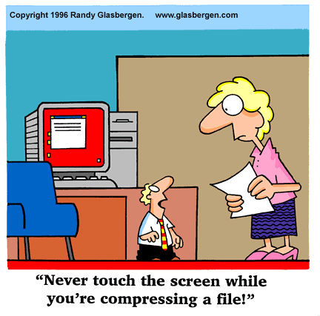

Slide 5
Entry Ticket
True or False?
T F
□ □ It is sufficient that a computer be able to read/write from memory and perform arithmetic operation.
□ □ Computers in 50s as well as 90s have a processor, memory and I/O as common elements.
□ □ The three requirements driving architecture are functionality, hardware technology and performance.
√
√
√

Slide 6
Entry Ticket
1. A source program is usually in _______
2. Name a memory device generally made up of semiconductors?
3. The control unit controls other units by generating ____
a) Control signals b) Timing signals c) Transfer signals d) Command Signals
4. A basic instruction that can be interpreted by a computer generally has
a. An operand and an address
b. A decoder and an accumulator.
c. Sequence register and decoder.
d. None of these

Slide 7
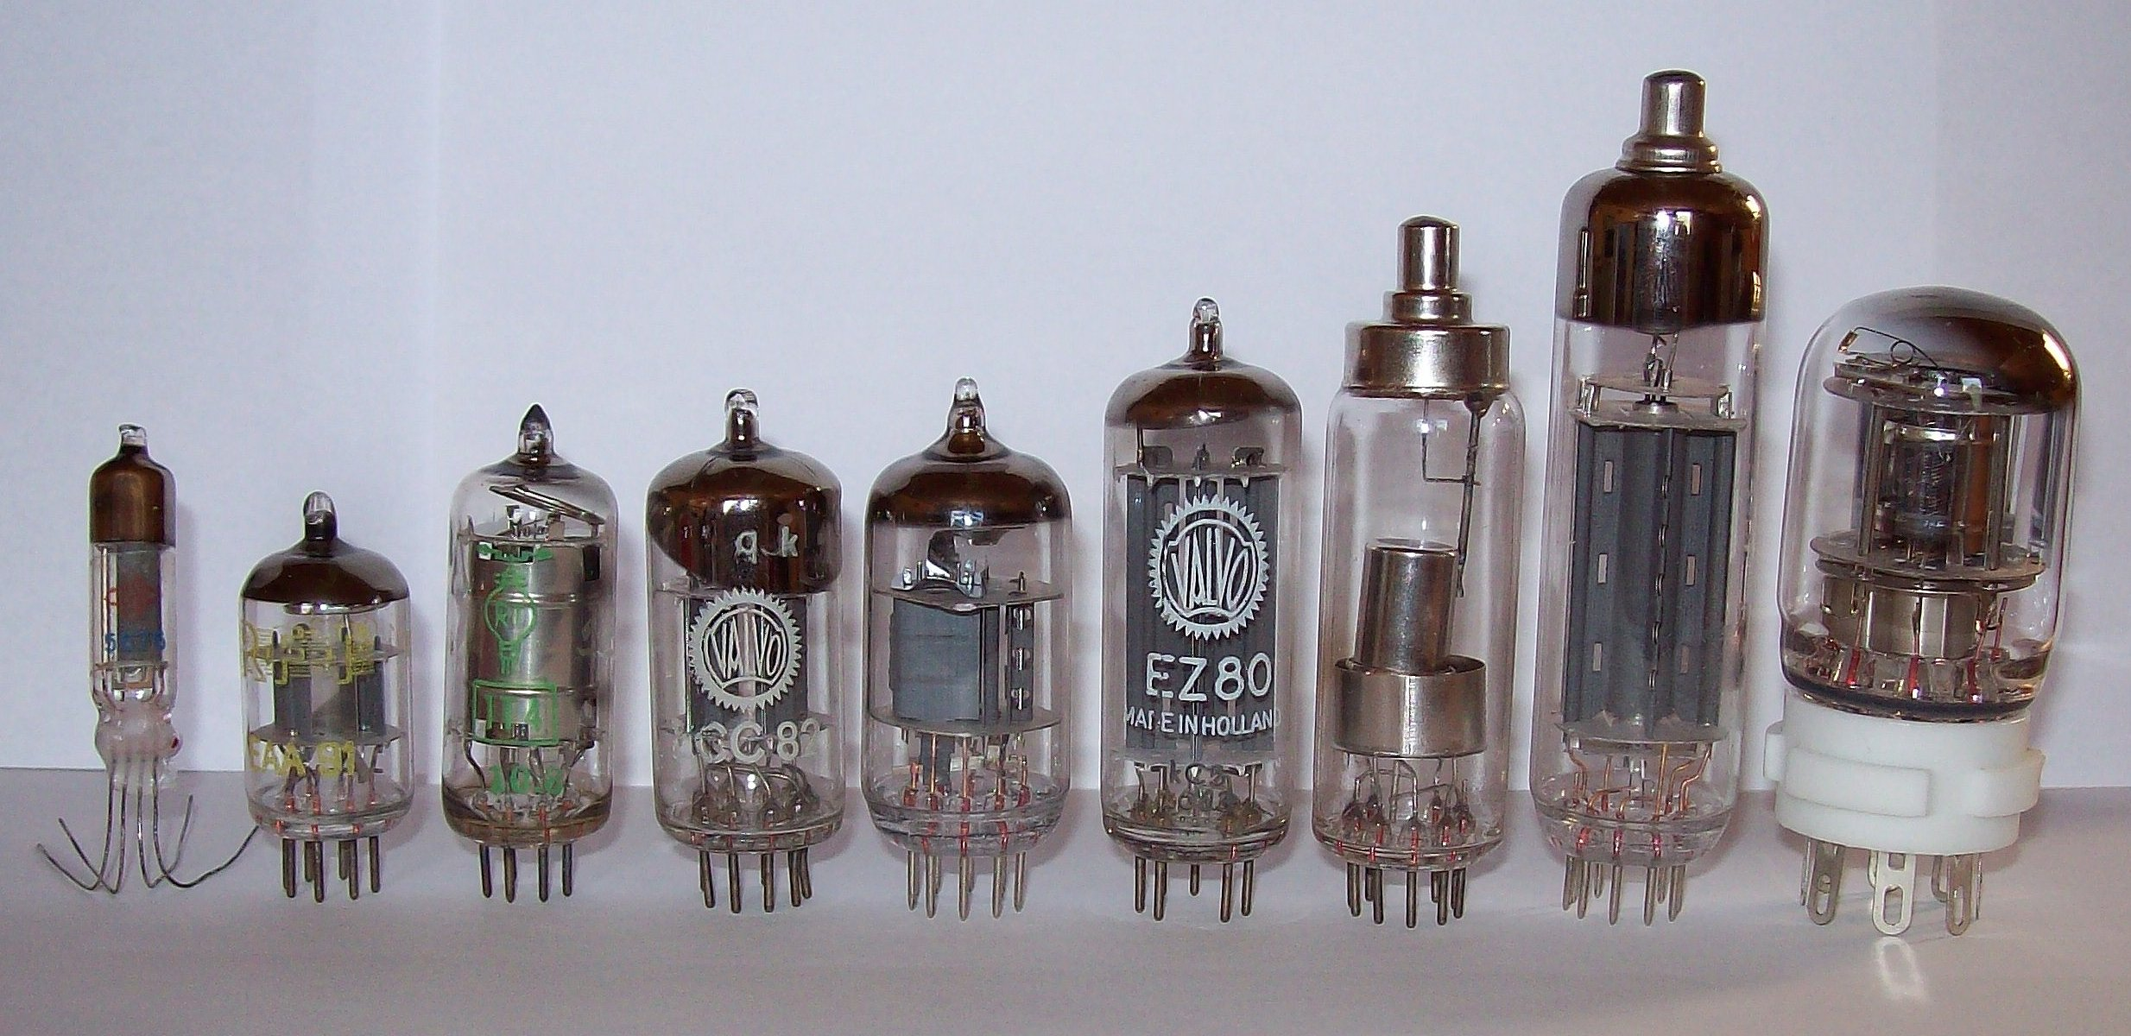
Vacuum Tubes (1940s)

Slide 8
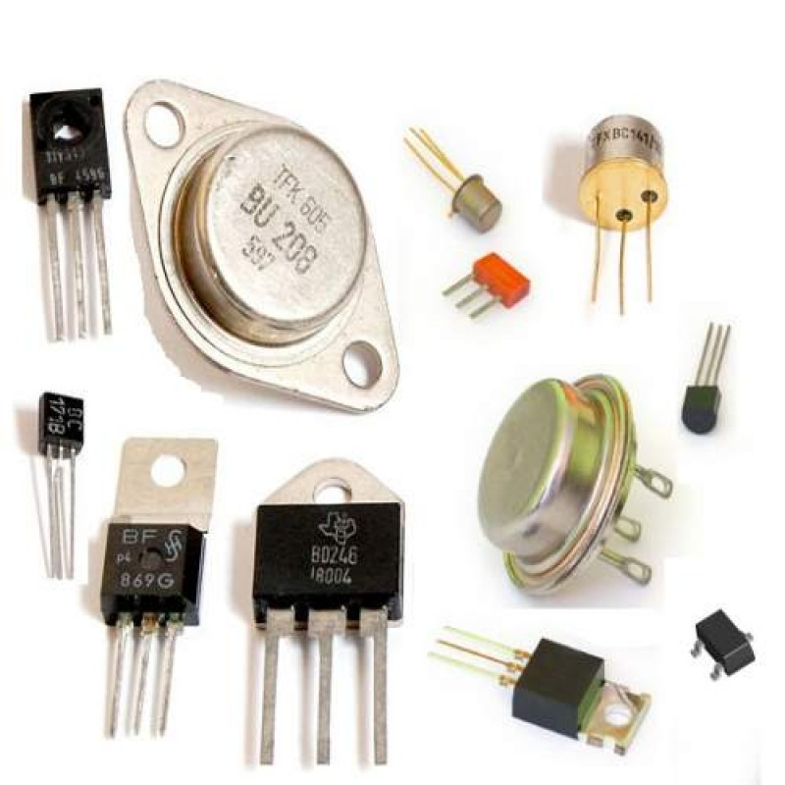
Transistors (1950s)

Slide 9
Defining Computer

Slide 10
Brief History of Computers

Slide 11
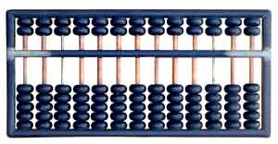
Manual calculating devices: The Abacus (c. 3000 BCE)
Notes:
The abacus is still a mainstay of basic computation in some societies. Slide the beads up and down on the rods to add and subtract.

Slide 12
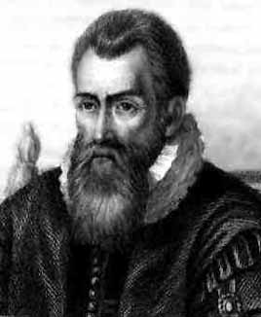
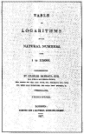
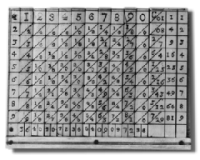
Napier’s Bones and Logarithms (1617)
Picture courtesy IBM
Notes:
John Napier, a Scotsman, invented logarithms which use lookup tables to find the solution to otherwise tedious and error-prone mathematical calculations. To quote Napier himself:
Seeing there is nothing (right well-beloved Students of the Mathematics) that is so troublesome to mathematical practice, nor that doth more molest and hinder calculators, than the multiplications, divisions, square and cubical extractions of great numbers, which besides the tedious expense of time are for the most part subject to many slippery errors, I began therefore to consider in my mind by what certain and ready art I might remove those hindrances. And having thought upon many things to this purpose, I found at length some excellent brief rules to be treated of (perhaps) hereafter. But amongst all, none more profitable than this which together with the hard and tedious multiplications, divisions, and extractions of roots, doth also cast away from the work itself even the very numbers themselves that are to be multiplied, divided and resolved into roots, and putteth other numbers in their place which perform as much as they can do, only by addition and subtraction, division by two or division by three.

Slide 13
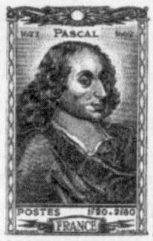
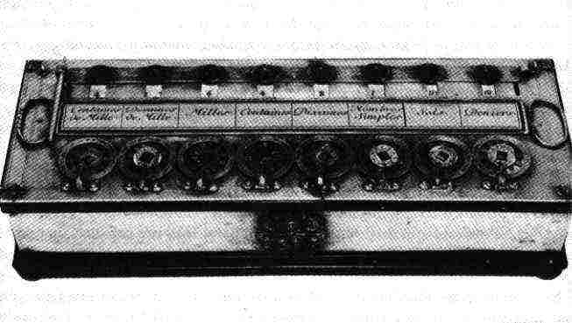
Blaise Pascal’s Pascaline (1645)
Mechanical Calculators
Notes:
This famous French philosopher and mathematician invented the first digital calculator to help his father with his work collecting taxes. He worked on it for three years between 1642 and 1645. The device, called the Pascaline, resembled a mechanical calculator of the 1940's. It could add and subtract by the simple rotation of dials on the machine’s face.

Slide 14
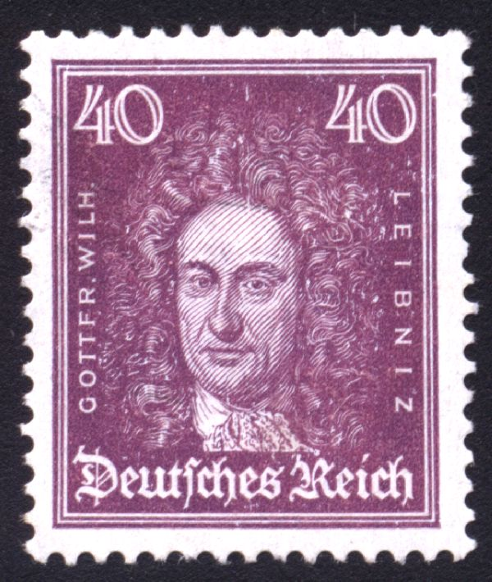
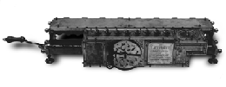
Gottfried Wilhelm von Leibnitz’s Stepped Reckoner (1674)
Notes:
Leibnitz’s Stepped Reckoner could not only add and subtract, but multiply and divide as well. Interesting thing about the Stepped Reckoner is that Leibnitz’s design was way ahead of his time. A working model of the machine didn’t appear till 1791, long after the inventor was dead and gone.

Slide 15
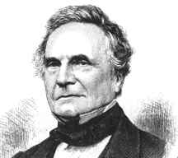
Charles Babbage (1791-1871) The Father of Computers

Slide 16
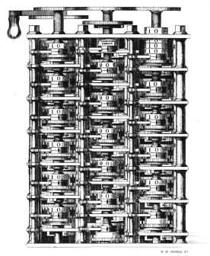
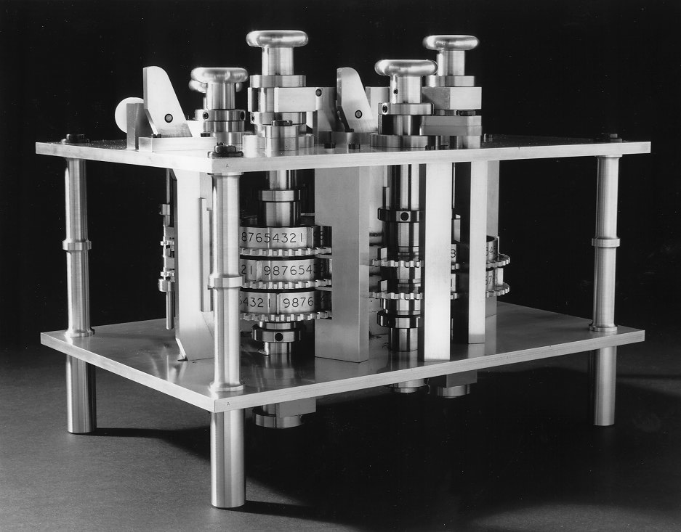
Charles Babbage’s Difference Engine

Slide 17
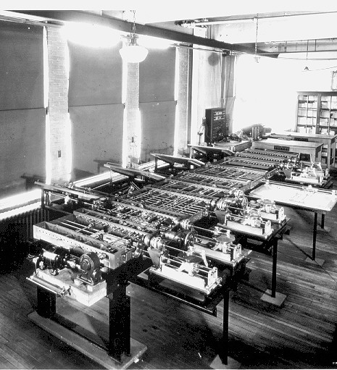
Charles Babbage’s Analytical Engine
http://www.sciencemuseum.org.uk/

Slide 18
List some other inventions by Prof. Charles Babbage

Slide 19
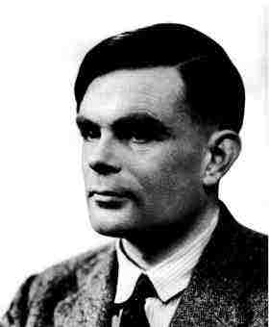
Alan Turing 1912-1954
The Turing Machine
Aka
The Universal Machine
1936
Notes:
The story of modern electronic digital computing should start with Alan Turing who published a paper in 1936 On Computable Numbers, with an application to the Entscheidungsproblem. The paper proved that a machine capable of processing a stream of 1s and 0s according to programmed instructions would be capable of solving any problem that would count as a 'definite method.' As it happens, the set of problems included in this definition is the universe of mechanically solvable problems. Hence, the Turing Machine is also known as the Universal Machine, the theoretical precursor to the electronic digital computer which Atanasoff was soon to invent.

Slide 20
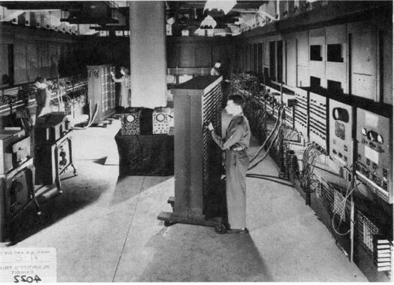
The ENIAC: Electronic Numerical Integrator and Computer
Notes:
The ENIAC: 30 tons, 18,000 vacuum tubes, with the computing power of little more than the modern calculator…..

Slide 21
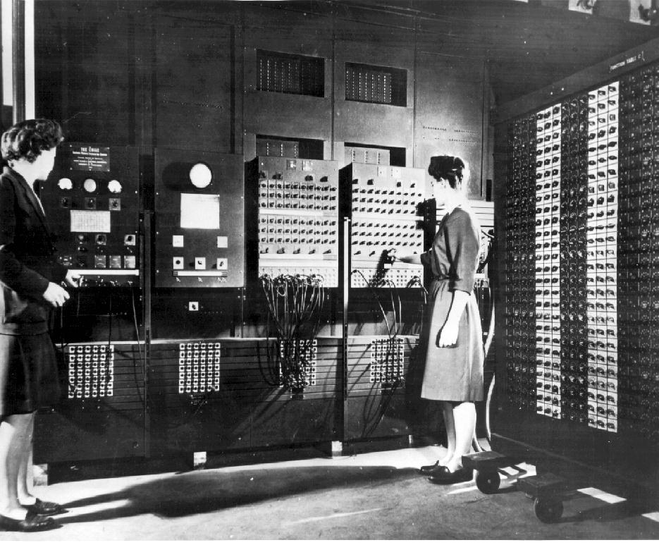
Programming the ENIAC
Notes:
The ENIAC was programmed by rewiring the machine, instruction by instruction, tedious work carried out mostly by women working for the U.S. Ordnance Office. The machine was intended for use in the calculation of ballistics trajectories for the big guns of World War II. It was ready a bit late for that, but nonetheless was an immensely significant achievement on Eckert and Mauchly’s part. Such a shame they neglected to recognize Atanasoff’s contribution to their endeavors.
The lady programmers were known as computers, for a while at least…..

Slide 22
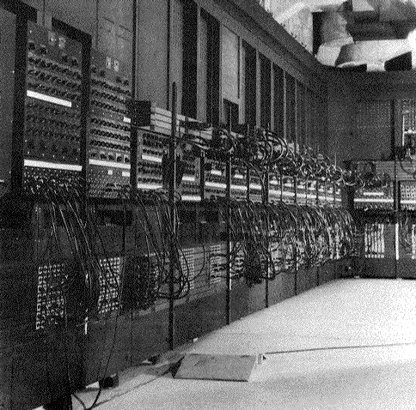
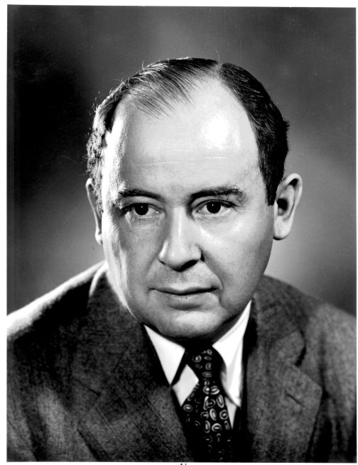
ENIAC’s Wiring!
John Von Neumann
John Von Neumann came up with the bright idea of using part of the computer’s internal memory (called Primary Memory) to “store” the program inside the computer and have the computer go get the instructions from its own memory, just as we do with our human brain.
Notes:
Like all the earliest electronic digital computers, the ENIAC was programmed manually; that is to say, the programmers wrote the programs out on paper, then literally set the program for the computer to perform by rewiring it or hard-wiring it—plugging and unplugging the wires on the outside of the machine. Hence all those external wires in the picture above and on the previous slide.
Then along came John Von Neumann, who worked at Princeton’s Institute for Advanced Study and who collaborated with Eckert and Mauchly. He came up with the bright idea of using part of the computer’s internal memory (called Primary Memory) to “store” the program inside the computer and have the computer go get the instructions from its own memory, just as we do with our human brain. Neato! No more intricate, complex, cumbersome external wiring. Much faster; much more efficient.
Unfortunately, it didn’t solve the problem of the possibility of error. As long as humans are around, we’ll always have that!
It’s iroonic that Eckert and Mauchly were upset when Von Neumann was given credit for this “stored program concept,” because they thought they deserved it, too. Now why didn’t they think the same about Atanasoff? Go figure!

Slide 23
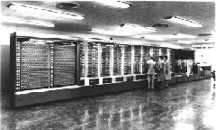
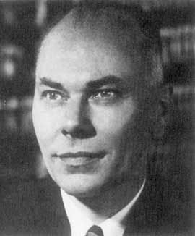
The Harvard Mark I (1944) aka IBM’s Automatic Sequence Controlled Calculator (ASCC)
Notes:
While a professor of Physics at Harvard, Howard Aiken, illustrated above, was supported by IBM to build the ASCC computer (Automatic Sequence Controlled Calculator). The computer had mechanical relays (switches) which flip-flopped back and forth to represent mathematical data. It was huge (of course), weighting some 35 tons with 500 miles of wiring. The guts of the machine was comprised of IBM counting machines.

Slide 24
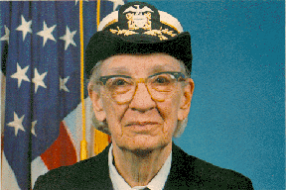
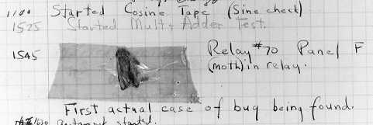
The first computer bug
Rear Admiral Dr. Grace Murray Hopper
Notes:
Rear Admiral Dr. Grace Murray Hopper
-------
The is a picture of the first computer bug. The lady is U.S. Rear Admiral Dr. Grace Murray Hopper, who worked with Howard Aiken from 1944 and used his machine for gunnery and ballistics calculation for the US Bureau of Ordnance’s Computation project. One day, the program she was running gave incorrect results and, upon examination, a moth was found blocking one of the relays. The bug was removed and the program performed to perfection. Since then, a program error in a computer has been called a bug, even though it would take a mighty tiny bug to interfere with the workings of a modern microscopic microprocessor.
Nancy Head has contributed the following additional information about Dr. Hopper:
Dr. Hopper greatly simplified programming through the COBOL language which was the first programming language to allow the use of regular English for variable names and logical operations. She also introduced the concept and standardization of "compilers“, now a standard feature of programming languages. The compiler translates the programmer’s code into machine language, thus sparing the programmer the onerous task of doing it it herself. This contributed to business use of computers and modern data processing because regular businesspersons and scientists (not just mathematicians and computer scientists) could learn to program computers.
More about her life and software engineering contributions can be found at http://www.sdsc.edu/ScienceWomen/hopper.html and http://www.cs.yale.edu/homes/tap/Files/hopper-story.html.
Some fun/interesting quotes from her can be found at http://www.cs.yale.edu/homes/tap/Files/hopper-wit.html.

Slide 25
Basic Information
The basic functional units of computer are made of electronics circuit and it works with electrical signal.
We provide input to the computer in form of electrical signal and get the output in form of electrical signal.
There are two basic types of electrical signals, namely, analog and digital.
The analog signals are continuous in nature and digital signals are discrete in nature.
Computer is a digital device, which works on two levels of signal. high-level signal (say 5 Volt or 12 Volt) and Low-level signal (say 0 Volt).

Slide 26
Basic Information
With the symbol 0 and 1, we have a mathematical system, which is knows as binary number system.
Basically binary number system is used to represent the information and manipulation of information in computer. This information is basically strings of 0s and 1s.
The smallest unit of information that is represented in computer is known as Bit.
Eight bits together is known as Byte, and Four bits together is known as Nibble.

Slide 27
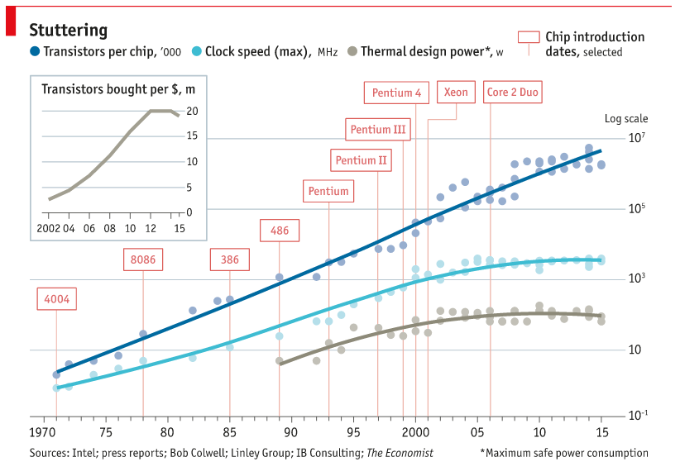

Slide 28
Computer Architecture
Computer architecture refers to those parameters of a computer system that are visible to a programmer or those parameters that have a direct impact on the logical execution of a program.
Examples of architectural attributes include the instruction set, the number of bits used to represent different data types, I/O mechanisms, and techniques for addressing memory.

Slide 29
Computer Organization
Computer organization refers to the operational units and their interconnections that realize the architectural specifications.
Examples of organizational attributes include those hardware details transparent to the programmer, such as control signals, interfaces between the computer and peripherals, and the memory technology used.

Slide 30
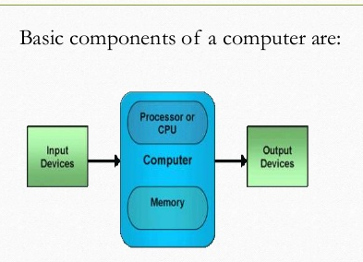
Basic Computer Model and functional units of Computer
The model of a computer can be described by four basic units in high level abstraction. These basic units are:
❍ Central Processor Unit
❍ Input Unit
❍ Output Unit
❍ Memory Unit

Slide 31
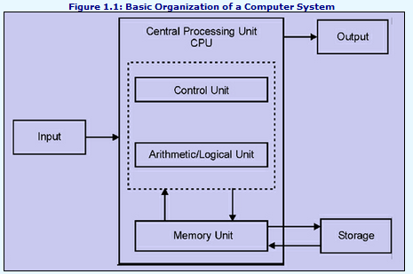

Slide 32
Von Neumann Model

Slide 33
A. Central Processor Unit [CPU] :
Central processor unit consists of two basic blocks :
❍ The program control unit has a set of registers and control circuit to generate control signals.
❍ The execution unit or data processing unit contains a set of registers for storing data and an Arithmetic and Logic Unit (ALU) for execution of arithmetic and logical operations.
In addition, CPU may have some additional registers for temporary storage of data.

Slide 34
B. Input Unit :
With the help of input unit data from outside can be supplied to the computer.
Program or data is read into main storage from input device or secondary storage under the control of CPU input instruction.
Example of input devices: Keyboard, Mouse, Hard disk, Floppy disk, CD-ROM drive etc.

Slide 35
C. Output Unit :
With the help of output unit computer results can be provided to the user or it can be stored in storage device permanently for future use.
Output data from main storage go to output device under the control of CPU output instructions.
Example of output devices: Printer, Monitor, Plotter, Hard Disk, Floppy Disk etc.

Slide 36
D. Memory Unit :
Memory unit is used to store the data and program. CPU can work with the information stored in memory unit.
This memory unit is termed as primary memory or main memory module.
These are basically semi conductor memories. There ate two types of semiconductor memories.
Volatile Memory : RAM (Random Access Memory).
Non-Volatile Memory : ROM (Read only Memory), PROM (Programmable ROM) EPROM (Erasable PROM), EEPROM (Electrically Erasable PROM)

Slide 37
Basic Working Principle of a Computer (TUTORIAL)
TUTORIAL
Consider a hypothetical computer
In this small computer, we do not consider about Input and Output unit. We will consider only CPU and memory module.
Assume that somehow we have stored the program and data into main memory.
Consider the Arithmetic and Logic Unit (ALU) of Central Processing Unit : Consider an ALU which can perform four arithmetic operations and four logical operations.
We will see how CPU can perform the job depending on the program stored in main memory.

Slide 38
Basic Working Principle of a Computer
To distinguish between arithmetic and logical operation, we may use a signal line,
0 - in that signal, represents an arithmetic operation and
1 - in that signal, represents a logical operation. In the similar manner, we need another two signal lines to distinguish between four arithmetic operations.
In the similar manner, we need another two signal lines to distinguish between four arithmetic operations.

Slide 39
Task of Control Unit
To generate the appropriate signal at right moment.
There is an instruction decoder in CPU which decodes this information in such a way that computer can perform the desired task.
The simple model for the decoder may be considered that there is three input lines to the decoder and correspondingly it generates eight output lines.
Depending on input combination only one of the output signals will be generated and it is used to indicate the corresponding operation of ALU.
In our simple model, we use three storage units in CPU, Two -- for storing the operand and one -- for storing the results. These storage units are known as register.

Slide 40
The different operations and their binary code is as follows:
Arithmetic
000 ADD
001 SUB
010 MULT
011 DIV
Logical
100 OR
101 AND
110 NAND
111 X-OR

Slide 41
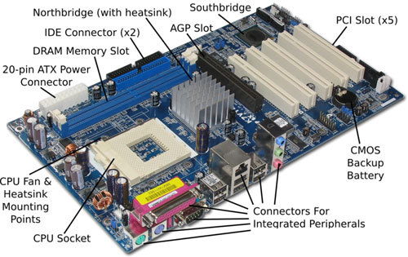

Slide 42
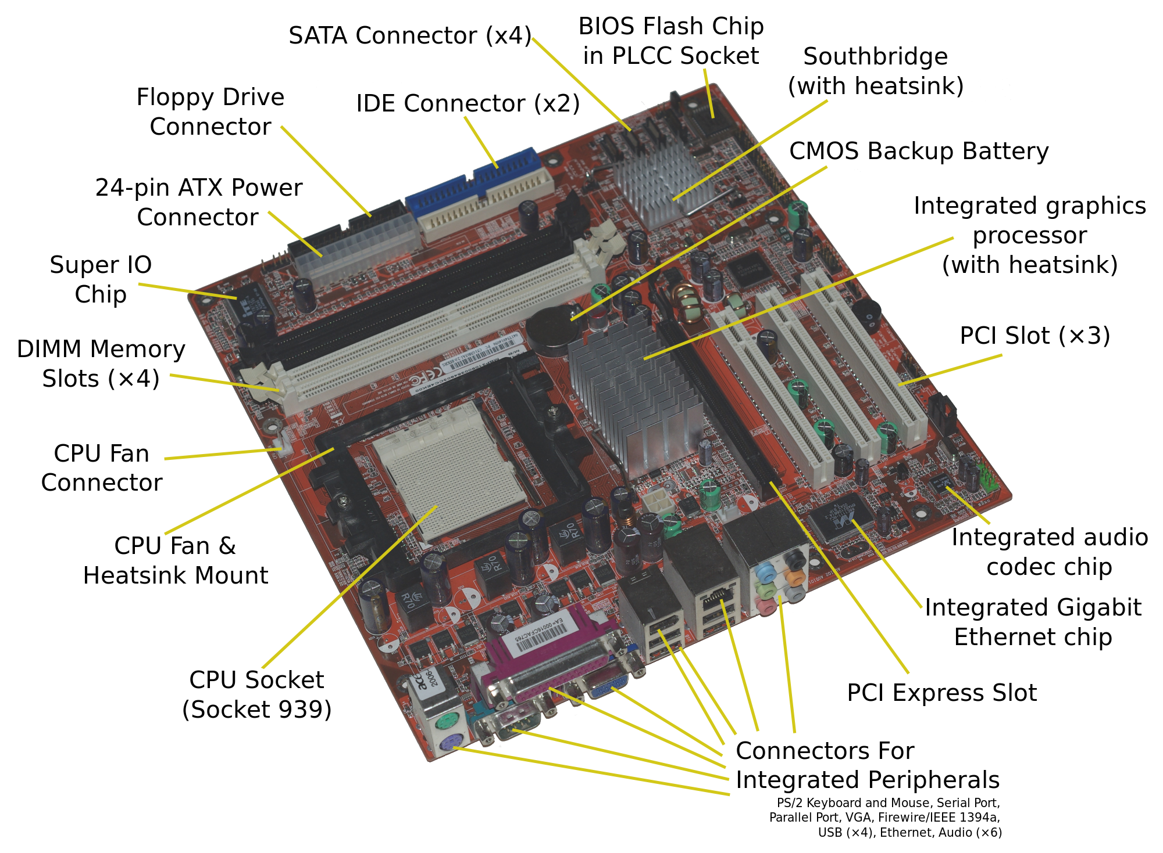

Slide 43
Questions

Slide 44
References

Slide 45
Definition of Computer must comprise following terms
Electronic device
input
Stores
Process (performs arithmetic and / or logical operations)
As per the instructions given
Typically uses binary language
Output

